Slide 1

CEF440 · INTERNET & MOBILE PROGRAMMING
GROUP 16
NetInsight: UI Design & Implementation
Task 5
Submitted to: Dr. Nkemeni Valery · 2025/2026

Slide 2


Introduction
NetInsight is a mobile application for real-time Quality of Experience (QoE) data collection from mobile network subscribers. It runs continuously in the background, periodically prompting users for subjective feedback while passively capturing objective network and device performance metrics.
The UI mediates all direct interactions between subscriber and data collection engine — a well-designed interface ensures sustained engagement, high data quality, and reliable longitudinal datasets.
01

Slide 3
NetInsight — Name, Concept & Mission
Name & Concept
Mission Statement
NetInsight = "Network" + "Insight" — converging objective telemetry with subjective QoE, shifting focus to human-centric connectivity in developing regions.
"Empowering mobile subscribers to share their real network experience automatically, honestly, and effortlessly."
Logo Symbolism
Outer eye ring = visibility & real-time oversight. Signal waves = mobile telemetry. Teal accent (#00D2C4) = modern, high-performance tech.
02

Slide 4
Brand Colour Palette & Typography
Typography System
Token
Colour
Hex
Headers: Bold, 22–24px — anchored uniformly across modal and static screens.
Subheadings & Metrics: Readable 12–14px scale.
Layout Geometry: Card-based architecture with border-radii of 10–14px for a modern feel and reduced visual fatigue.
Primary Background
Dark Sapphire Blue
#173F7A
Card / Widget
Cobalt Blue
#1B4A8F
Teal Accent
Robin's Egg Blue
#00D2C4
Muted Typography
Ice Blue
#A0B2CE
Static Light Gray
Alice Blue
#E0E6ED
Coverage Indicators
Green / Yellow / Red
#2ECC71 / #F1C40F / #E74C3C
03

Slide 5
UI Screen Flow — 7 Screens
User journey optimised to secure explicit permissions before data logging begins.
01
02
Language Selection
Privacy & Permission
Bilingual gateway — English / French with teal accent border.
Three checkboxes: Privacy Terms, Background Location, Anonymous Telemetry.
03
04
Dashboard
Map Coverage
2×2 matrix: Download Speed, Upload Speed, Network Type, Latency.
Live colour-coded cellular coverage nodes over geographical map.
05
06
Network History
Settings
Timeline with "Today / Week / Month" filters for operator telemetry logs.
Runtime flags, prompt intervals (e.g., Every 4 Hours).
04

Slide 6
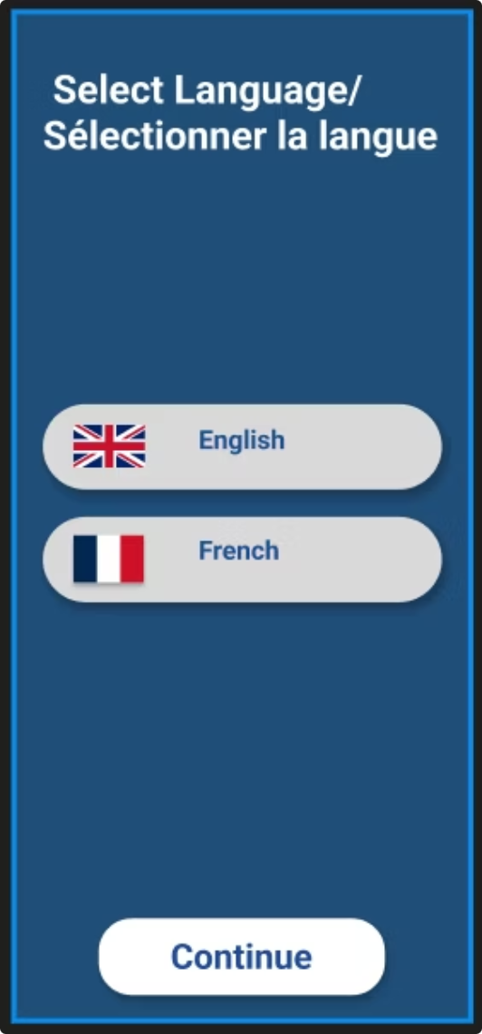
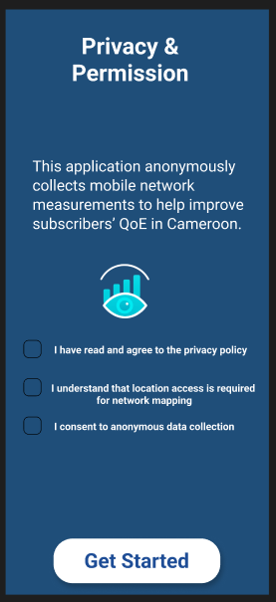
Language and Permission Screens
05

Slide 7
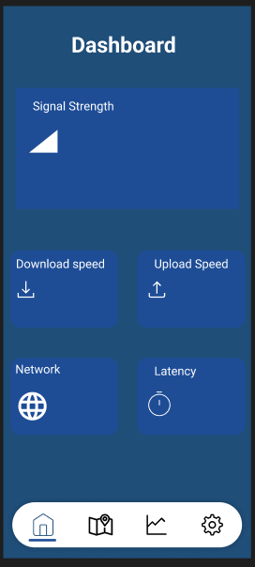
Dashboard Screen
Network Status Card: 5G/4G/3G/2G, signal bars, operator, colour-coded badge
Metric Tile Grid (2×3): Signal Strength, Latency, Jitter, Packet Loss, Download Speed, Battery/CPU
QoE Score Panel: Latest satisfaction score with 7-session sparkline
Background Indicator: Pulsing dot confirming active monitoring
06

Slide 8
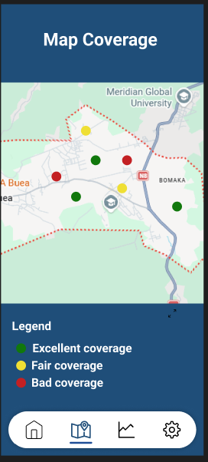
Map Coverage Screen
Google Maps SDK with custom heatmap overlay. Red → Amber → Green gradients for signal/QoE. Toggle Signal Strength or QoE Score mode.
07

Slide 9
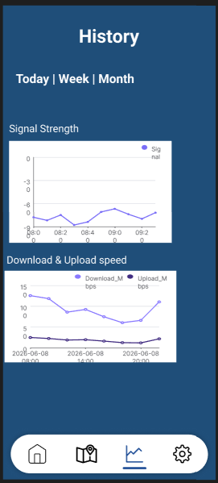
History Screen
Chronological session cards with date, network type, QoE score, and metric summary.
08

Slide 10
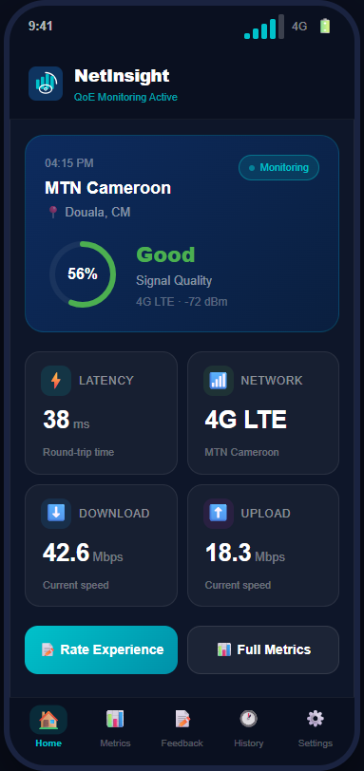
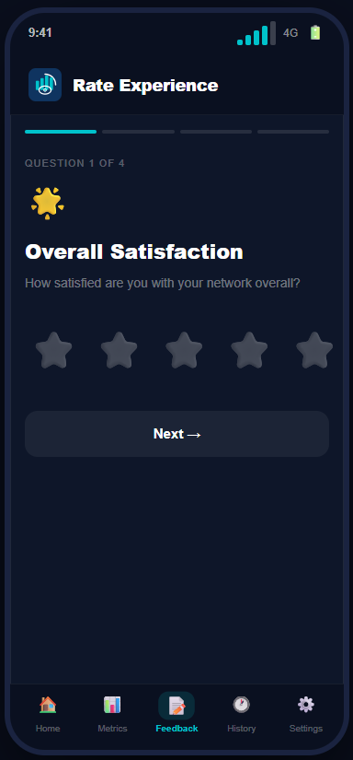
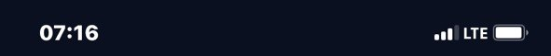
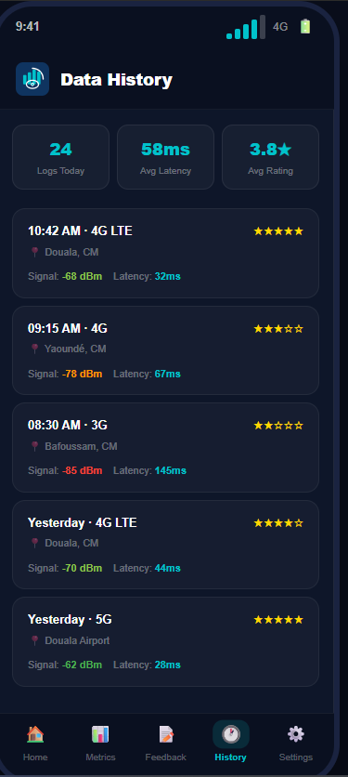
React Native Implementation
Why React Native?
Cross-platform: single codebase for Android & iOS
Near-native performance via native components
Component-based, modular architecture
Hot reload for rapid iteration
Key Implemented Features
User onboarding flow
Feedback input forms for QoE reporting
Network quality rating system
Multi-screen navigation (React Navigation)
09

Slide 11


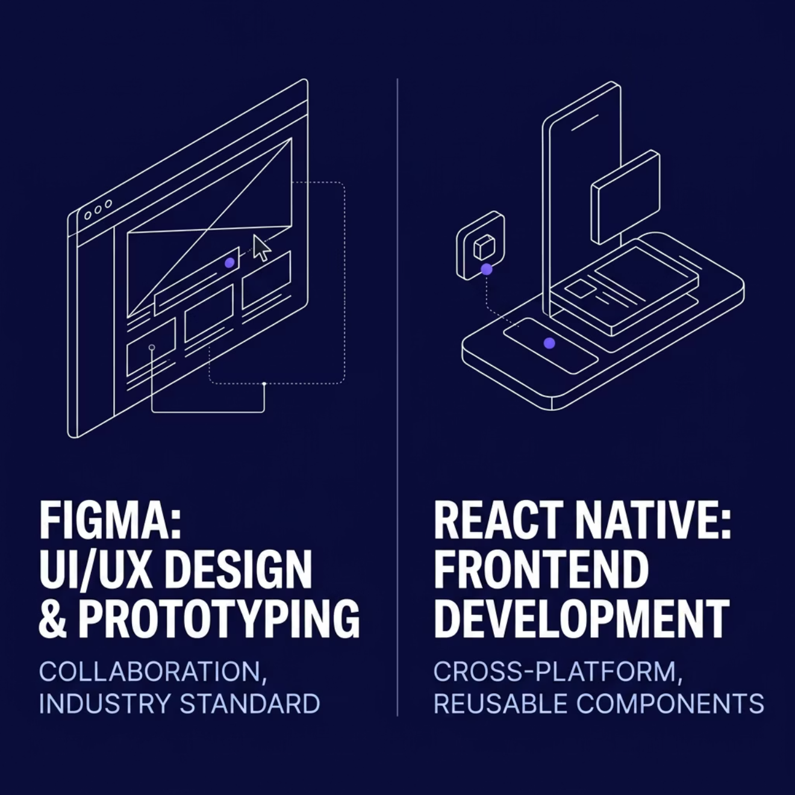
Tools Summary & Conclusion
Conclusion
The UI design and implementation phase successfully translated conceptual designs into a functional mobile interface. Figma enabled structured, user-centred visual design; React Native delivered a responsive, scalable frontend.
The combination ensured design-to-implementation consistency.
WHAT NEXT:
Database Design and Implementation
10

